Slide 1


//Developers_Institute_
TLV Coding Bootcamp
</RestoBot>
Developers Institute ranked for Best Coding Bootcamp Worldwide for 2023
Azerbaijan 🇦🇿- México 🇲🇽 - Cameroon 🇨🇲 - Senegal 🇸🇳 - Burkina Faso 🇧🇫 - Mali 🇲🇱 - Ghana 🇬🇭 - Togo 🇹🇬 - Mauritius 🇲🇺 - Morocco 🇲🇦 - India 🇮🇳 - Georgia 🇬🇪 - Israël 🇮🇱

Slide 2
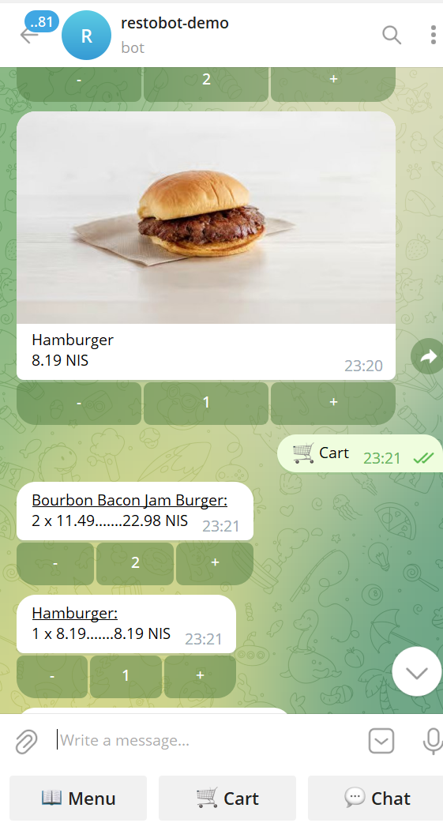
RestoBot
The project aims to facilitate communication between restaurants and their clients using a Telegram bot.
The clients can access the restaurant's menu, place orders, and inquire about dishes directly through the chatbot.
On the restaurant side, there is a web application that allows menu editing, real-time order management, client communication, and the option to send mailings to all clients.

Slide 3
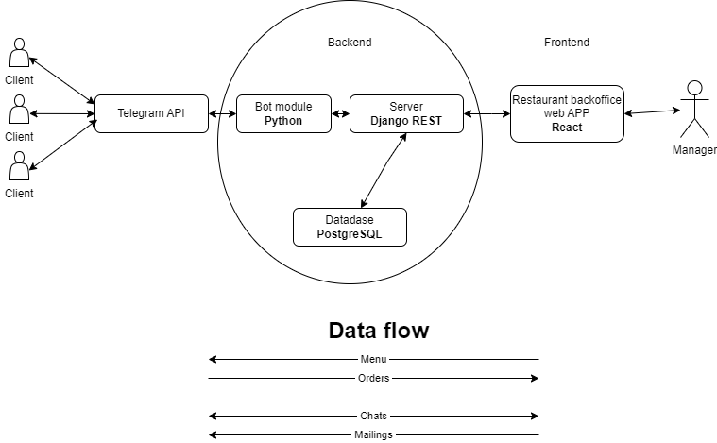
Stack
Database: PostgreSQL
Backend: Django Rest, Python
Bot Module: Aiogram, Python
Frontend for restaurants: React, JS

Slide 4
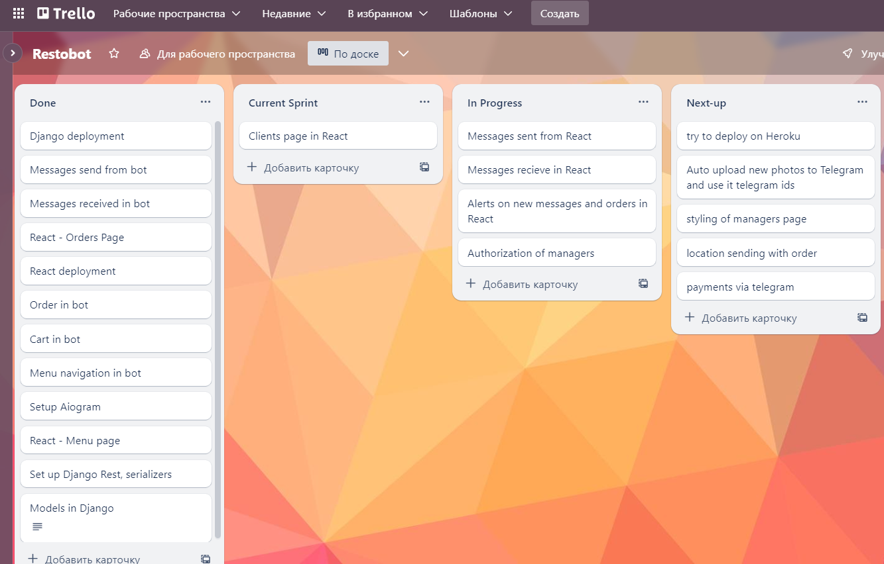
Feature list
For Managers in the Web App:
Edit the menu by adding, editing, or deleting dishes, and create categories.
Add dishes to the stop-list (temporarily remove them from the menu).
Receive and approve incoming orders.
Send messages directly to individual clients.
Send mass mailings to all clients.
For Users on Telegram:
Access the restaurant's menu, view pictures, descriptions, and prices of dishes.
Explore different categories within the menu.
Search for specific dishes by name.
Add dishes to the cart.
Calculate the total price of the order.
Provide necessary details and submit the order.
Engage in direct communication with the restaurant through messages.

Slide 5
Link
Github links:
Django Backend + Telegram module https://github.com/DmitryArtamonov/Restobot
React Frontend https://github.com/DmitryArtamonov/Restobot_admin
2-mn video link
Deployed https://t.me/demo_restobot
Portfolio https://dmitryartamonov.github.io/Portfolio/

Slide 6
Career Prep
CV https://dmitryartamonov.github.io/Portfolio/Dmitry_Artamonov_CV.pdf
Linkedin https://www.linkedin.com/in/dmitry-artamonov-660b16267/

Slide 7
Roadmap
Django models, serializers, Database
Cart and Order in bot
Chats i/o in bot
Admin page: Menu editor
Deployment attempt
Orders list on Admin page
Setup the bot
Deployment attempt
Menu navigation in bot

Slide 8
Next steps:
Deployment
Messages i/o on admin page
Clients page
New message / order alert
Authorization for admins
Styling of the admin page
Location sending with the order
Payments via Telegram

